Slide 1

TRAFFIC SUDHARO-User services
NAME:ADAPA GANESH
ROLL nO:18699F0019
DEPARTMENT: mCA 2YEARS
GUIDE NAME: Mr. v. Maruthi Prasad

Slide 2
Abstract:
As the name suggests, Traffic Sudharo is a great initiative enabling the Citizens to report Traffic Violations to the appropriate authority this application. This enables the user to Post Issue (Traffic Violation) by capturing the Photos from the Mobile Camera and it will automatically read the Geo Location, Date and Time Etc. It will also allow the users to report the images which they’ve captured out of the application. The Issues reported will be verified by Traffic Sudharo Back end team for obnoxious or obscure images and approves or rejects the issue.

Slide 3
inTRODUCTION:
“Traffic Sudharo”, first the user can register, and then login into the page, the first page consists of camera, submit, cancel buttons. Whenever the user saw the Traffic violations like Cell Phone Driving, Signal Jump, and so on. User can take the violation Picture, select the violation type and click on the Submit button after clicking the submit button, the information is transformed to the Admin(Admins are Police Officers) level.
Once the Admin will approved that Request then the user can get the rewards, and also appreciation awards will get by the Government. Without Register into the page, any one can rise the issue , but only the Registered User’s will get Rewards.

Slide 4
existing system
The Police Officers can only having the rights to take the violation pictures, when the traffic violations are happening at anywhere.

Slide 5
dis advantages
violation rate compulsory increased why because the police officers are focusing only on one place.
The traffic violaters are increased because difficult to catch more traffic violaters.
The police can only having the permission to take pictures of traffic violation, but not for the people's which leads to increase traffic violations.
More Number of Police officers will work on that by standing different areas.
They need a Special device for that particular purpose.

Slide 6
proposed system
These is a web based as well as an android application, but here we are providing the access to the Public as well as police officers, the people can take pictures related to traffic violations, then the admin (police officer) will be the responsible person to make fine when the user request approved. Suppose admin will get same violation multiple times, at that time only it follows First Come First Serve (FCFS) basses remaining requests will be negligible.

Slide 7
aDVANTAGES
Everyone having the right to punish traffic violators,and to support police officers for controlling traffic accidents.
Number of dependences will decreases.
There is no special device needed for this application, it will work on any smartphone.
Only one police officer is enough for a entire city.
User will get rewards.
By the help of this, traffic violation will surely reduce, why because all traffic violaters are fear of everyone.

Slide 8
Software specifications:
Operating System - Windows 7/8/10 or higher.
Application Server - Tomcat 8.0
Front End - HTML,CSS,BootStrap.
Scripts - JavaScript
Server side Script - Java Server Pages
Database - MySQL

Slide 9
hardware specifications:
Processor - i3/i4/i5 Processor
RAM - 4GB
Hard Disk - 250GB

Slide 10
Module Description:
the project “TRAFFIC SUDHARO” contains mainly two modules they are given bellow :
User
Admin

Slide 11
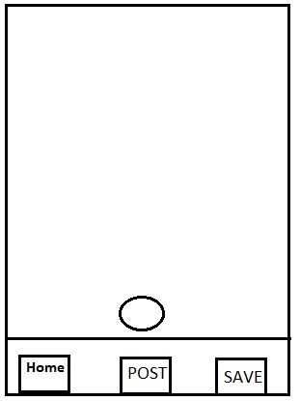
MODULE DESCRIPTION
When user click on the Traffic Sudharo App, Camera should be launched automatically to capture the violation picture and the launch screen will be as shown below.
Launch screen should have the 3 options. i.e.
1. Post
2. Save
3. Home

Slide 12
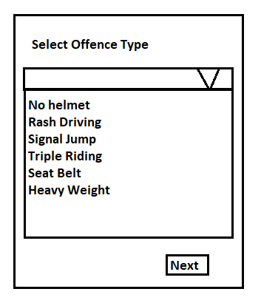
1.POST SCENARIO :
User is clicks on “Post” button the control goes to next page showing list of offence type.
After selecting respected offence type then user click on Next button window will come with reward point condition.

Slide 13
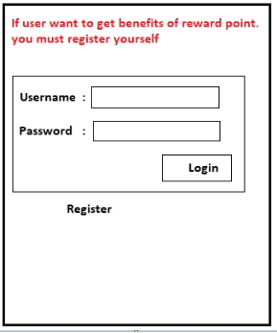
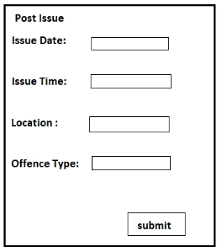
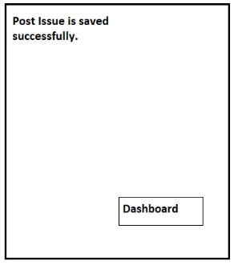
SCENARIO - A :
If user is already registered before he can use his credentials and login directly.
User can add the details in “Post Issue”
H
If user clicks on submit button then the post is saved successfully in database and it will display the one successful message.

Slide 14
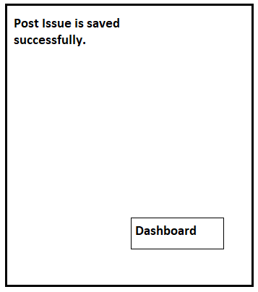
SCENARIO- A
If user clicks on submit button then the post is saved successfully in database and it will display the one successful message.

Slide 15
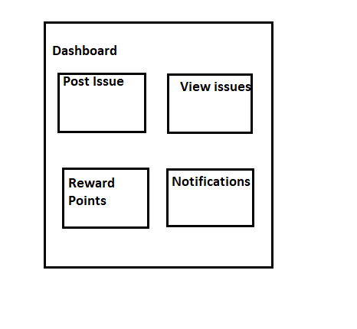
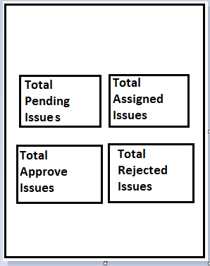
SCENARIO - A
User clicks on Dashboard then the window will come like this.
There are sub modules in View Issues that is be like this
User can see the entire thing what he already post previously.

Slide 16
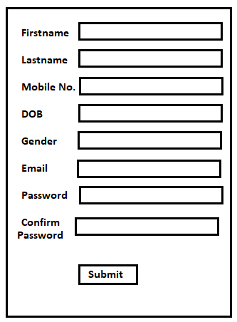
SCENARIO - A
User should be registered with the App, if he/she was a first time user.
Registered Page
On clicking submit button, user record is saved and it displays one message like registered successfully.

Slide 17
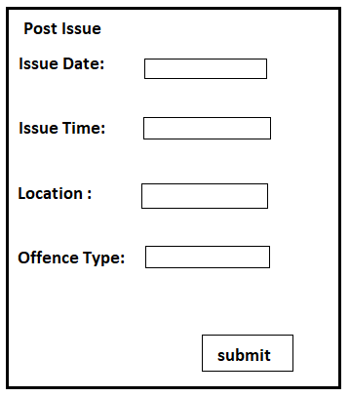
SCENARIO - A
User can add the details in “Post Issue”
If user clicks on submit button then the post is saved successfully in database and it will display a one successful message.

Slide 18
SCENARIO - A
User clicks on Dashboard then the window will come like this.
There are sub modules in View Issues that is be like this
User can see everything in this menus and user can logout.

Slide 19
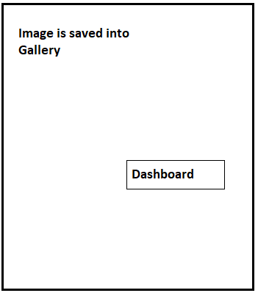
2.SAVE SCENARIO:
If user wants to Post the violation in later stage (Off-Line Mode), user can capture the image and SAVE the violation image into the Gallery.
User will get the confirmation message like: “Image is saved into Gallery”.

Slide 20
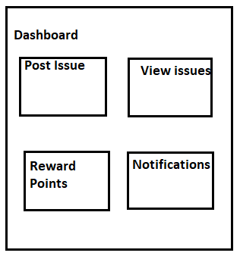
2.SAVE SCENARIO:
When User click on the Dashboard button the following screen should be displayed (Dashboard page).

Slide 21
2.SAVE SCENARIO:
User can post the issue or later he can post
Whenever user click on “Post Issue” button and window will be open like this
If user clicks on submit button then the post is saved successfully in database and it will display a one successful message.

Slide 22
2.SAVE SCENARIO:
User clicks on Dashboard then the window will come like this.
There are sub modules in View Issues that is be like this
User can see everything in this menus and user can logout.

Slide 23
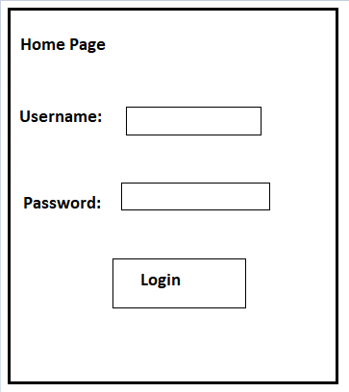
3.HOME SCENARIO:
If user wants to see the Dashboard, Reward points, View Issues etc, User has to click on the “Home” button.
When user clicks on the “Home” option, user redirected to Home page.
•SCENARIO A (Registered User)

Slide 24
3.HOME SCENARIO:
If user is already registered before he can use his credentials and login directly.
User can see posts everything what he has posted previously.

Slide 25
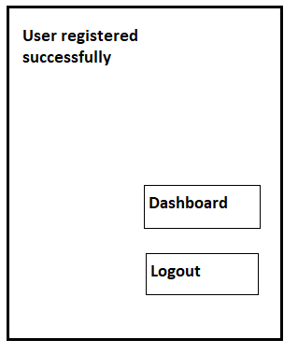
SCENARIO - B (First Time User)
User should be registered with the App, if he/she was a first time user.
Registered Page
On clicking submit button, user record is saved and it displays one message like registered successfully.

Slide 26
3.HOME SCENARIO:
If user is click on Dashboard, it directly goes to Dashboard

Slide 27
4.View Issues
User can see all his Posted issues.
User can see the total pending post, total assigned post, reward points and notifications.
•If User clicks on “Total Pending Post” option, user can see all the Pending Issues.
•If User clicks on “Total Assigned Post” option, user can see all the posts which are assigned to Agents.
•If User clicks on “Total Approved Post” option user can see all Approved Issues.
•If User clicks on “Total Rejected Post” option, user can see all the Rejected Issues.

Slide 28
UML DIAGRAMS:
There are different types of UML Diagrams :
In my project i drawn these bellow Uml Diagrams,
1. Use case diagram
2. Sequence diagram
3. Activity diagram
4. Component diagram
5. Class diagram
6. collaboration diagram

Slide 29
Usecase diagram :
A use case diagram in the Unified Modeling Language (uml) is a type of behavioral diagram defined by created from a Use-case analysis. Its purpose is to present a graphical overview of the functionality provide by a system in terms of actors,their goals(represented as use case),and any depedencies between those use case. The main purpose of the use case diagram is to show what system functions are performed for which actor.Roles of the actor in the system can be depicted

Slide 30
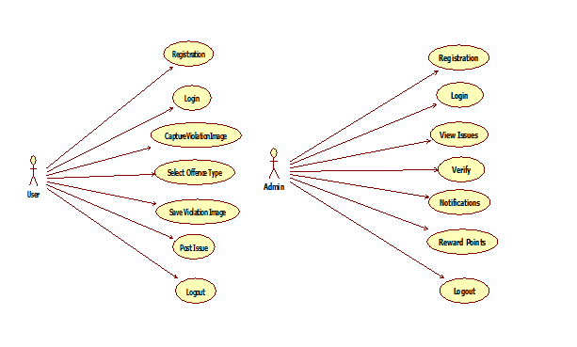
Usecase diagram :

Slide 31
Sequence diagram
Sequence diagram is a kind of interaction diagram that shows how processes operate with one another and in what order.it is a construct of a message sequence chart.sequence diagram are sometimes called event diagrams,and also timing diagrams.

Slide 32
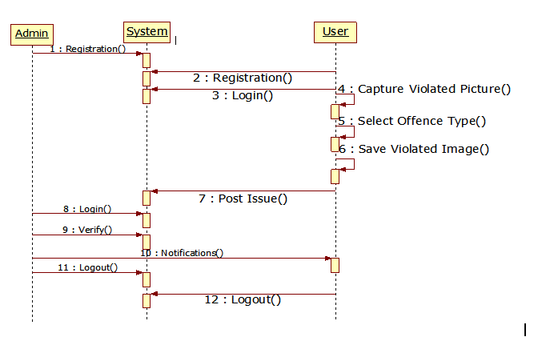
Sequence diagram

Slide 33
Activity diagram
Activity diagram are graphical representations of workflows of stepwise activities and actions with support for choice,iteration and concurrency. In the UML,activity diagram can e used to describe the business and operation step-by-step workflows of components in a system,an activity diagram shows the overall flo of control.

Slide 34
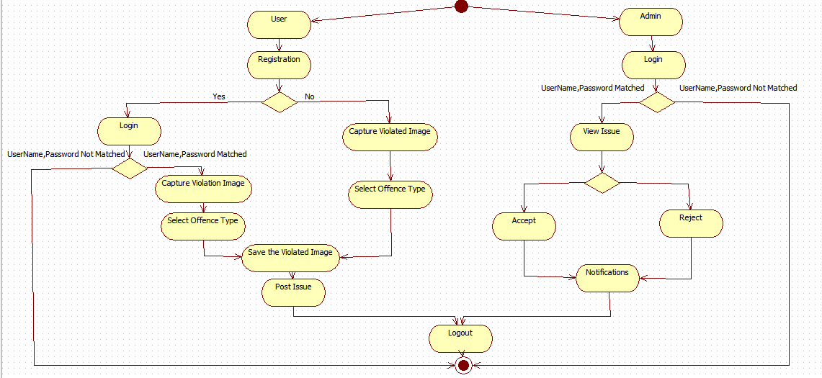
Activity diagram :

Slide 35
Component diagram
Component diagram are used to describe the physical artifacts of the system.this diagrams are used during the implementation phase of an application. But it is prepared well in advence tp visualize the implemantion details.when the artifacts are reddy component diagrams are used to get an idea of the implementation.

Slide 36
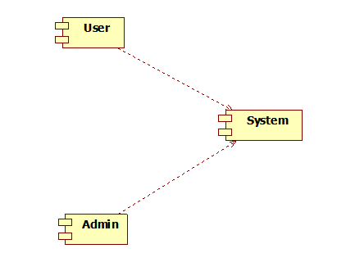
Component diagram

Slide 37
Class diagram:
A class diagram is a type of static structure diagram that describes the structure of a system by showing the system's classes,their attributes,opereations,and the relationship among the classes. It explains which class contains information.

Slide 38
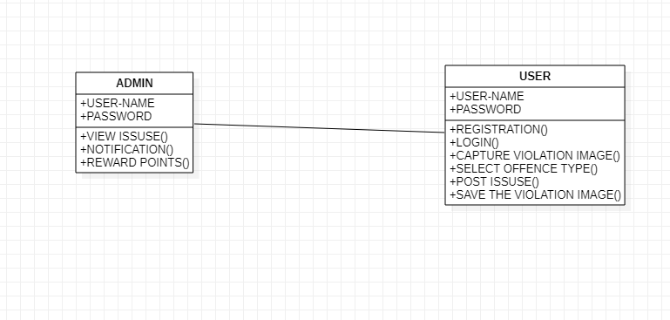
Class diagram

Slide 39
collaboration diagram
In collaboration diagram, the method call sequence is indicated by some numbering technique as shown below. The number indicates how the methods are called one after another. We have taken the same order management system to describe the collaboration diagram. The method calls are similar to that of a sequence diagram. However, the difference is that the sequence diagram does not describe the object organization where as the collaboration diagram shows the object organization. The figure below shows the collaboration diagram of the Traffic Sudharo Application.

Slide 40
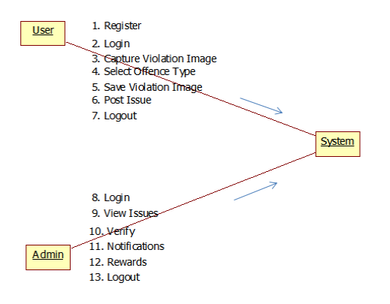
COLLABORATION DIAGRAM

Slide 41
ER-DIAGRAM
An Entity-relationship model(ER model) describes the structure of a database with the help of a diagram, Which is known as Entity Relationship Diagram(ER Diagram). An ER model is a design or blueprint of a database that can later be implemeted as a database. The main components of ER model are:
Entity set and Relationship set.

Slide 42
ER-Diagram
Rectangle: Represents Entity sets.
Ecllipse : Attributes
Diamonds: Relationships set.
Lines : They link attributes to Entity Sets and Entity sets to Relationship set.
Double Ecllipse: Multivalued Attributes.
Dashed Ecllipse: Derived Attributes.
Double Rectanges: Weak Entity Sets.
Double Lines: Total participation of an Entity.

Slide 43
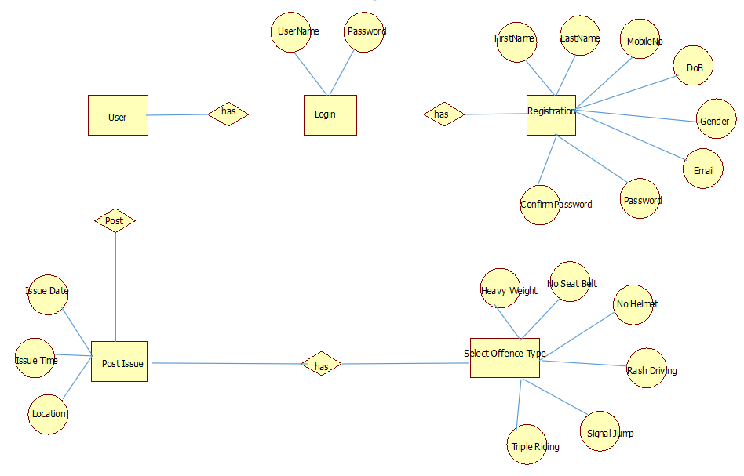
ER-Diagram FOR USER:

Slide 44
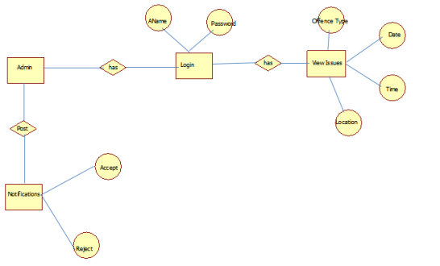
ER DIAGRAM FOR ADMIN:

Slide 45
Data Flow Diagram
A Data-Flow Diagram (DFD) is a way of representing a flow of a data of a process or a system(usually an information system). The DFD also provides information about the outputs and inputs of each entity and the process itself. A data-flow diagram has no control flow, there are no decision rules and no loops.

Slide 46
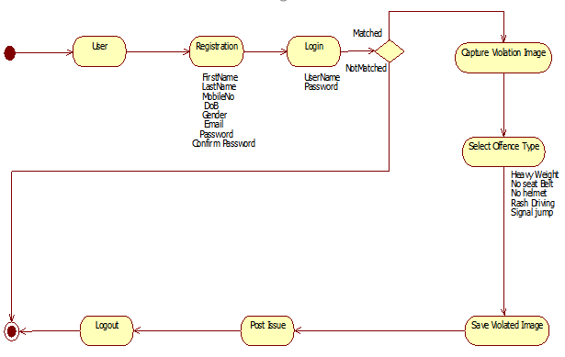
Data Flow Diagram FOR USER:

Slide 47
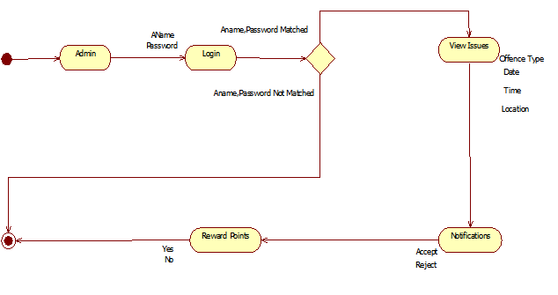
DATA FLOW DIAGRAM FOR ADMIN:

Slide 48
SCREEN SHOTS OF APPLICATION...

Slide 49

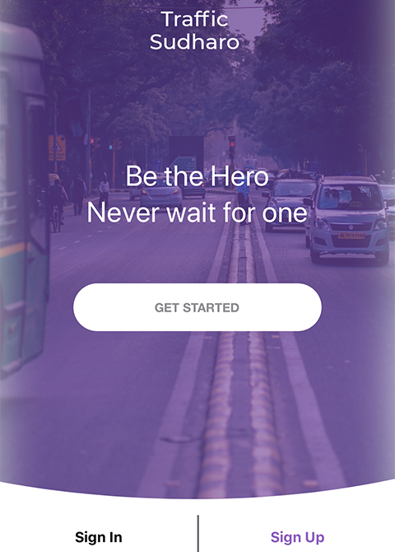
HOME PAGE:
This is the first page that displayed to the user after opening the application
The user want to post any violation that he captured,then he/she need to login/sign into the application
If the user is already registered, they can simply login ,otherwise they need to register.

Slide 50
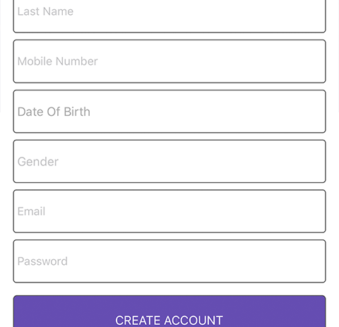
Registration page:
This is the registration slide ​
Who are not registered then they can register ​
After register only they can post any violation and they can get rewards to their posts​

Slide 51
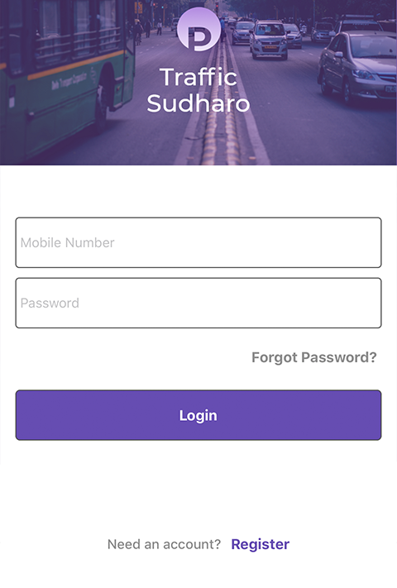
Login Page:
If the user is already registered then they can simply loginbyusing their credentials
Username has tobe mobile number
And password shold be as per rule some special charecters and numbers and alphabets
If they forgot the password aslo there is an option to reset the password by cliking the forgot password

Slide 52
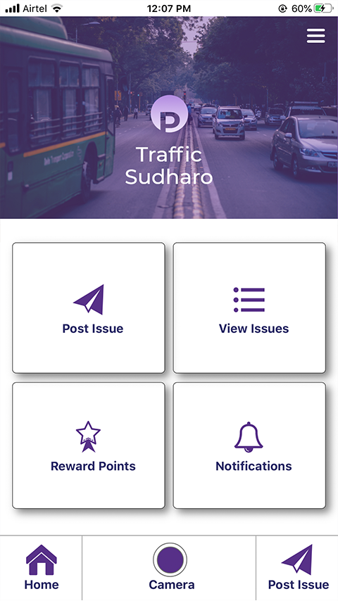
dashboard page:
This is the slide which is having post issue option and view issue option and reward points and notifications

Slide 53
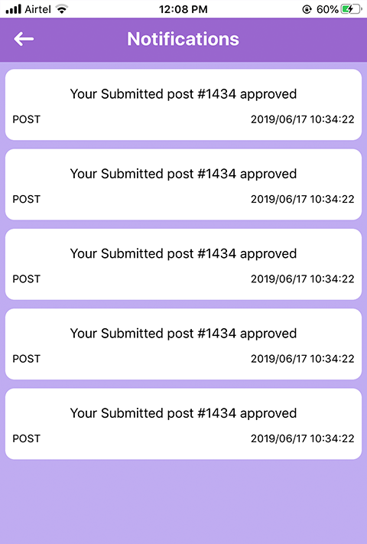
Notification page:
Noificaion page wil display the notifications about the user any violation is posted and that was valid then it will be approved
After approving the user can get the notification as your submitted post is aproved
And also if any rewards are aproved to that violation then also they will get notification

Slide 54
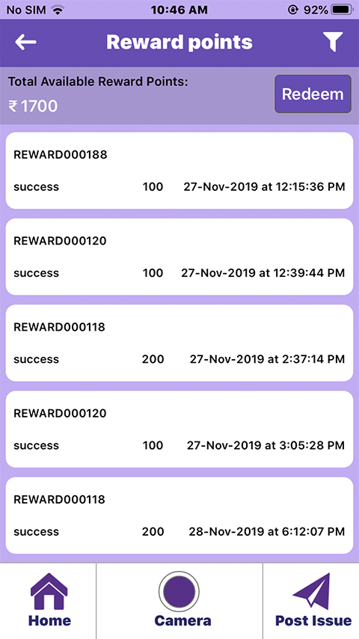
Rewards page:
This page will show the all the rewards that got the user
Firstly they give rewards as a points then the user can redeem the points as money

Slide 55
Testing Description
Testing is the process of detecting the errors in the program.
Testing performs a critical role for quality assurance and for ensuring the reliability of the software.
The results of testing are also used later on during maintenance also.
The aim of the testing is often to demonstrate that the program works by showing that it has no errors.
Testing is the process of the executing a program with the intent of finding errors.

Slide 56
Testing Fundamentals
The main objective of testing is to uncover a host of the errors, systematically and with minimum effort and time. Stating formally, we can say,
Testing is the process of executing a program with the intent of finding an error.
The successful test is one that uncovers an as yet undiscovered error.
A good test case is one that has a high probability of finding the error, if it exists.

Slide 57
Testing Types
Software testing is a critical element of software quality assurance and that represents the ultimate review of the specification, design, coding.
The engineer creates a serious of the test cases that are intended to “demolish” the software that has been built.
In fact, testing is the one step in this software engineering process that could be viewed as destructive rather than constructive.
The testing process is divided several components as follows
a)Unit Testing
b)Integratration Testing
c)Validation Testing
d)System Testing

Slide 58
Unit Testing
The software is tested using the unit test method.
Unit testing focuses on the smallest unit of the software design module.
Using the procedural design description as a Staff, important control parts are tested to uncover errors within the boundary values of the module.
Features to be tested:
Verify that the entries are in the correct format
No duplicate entries should be allowed
All links should take user to the correct page.
Every module in the project is checked for verification

Slide 59
Integration Testing
This testing is the systematic technique for constructing program structure by performing the test in each module and later combining that entire individual module to form a very large program

Slide 60
vAlidation testing
Validation testing is a process of testing the input.
When working with databases it is important to validate a user’s entries, which can be done by using scripting code on the front end.
The terms verification and validations are used interchangeably we will describe both these methods.

Slide 61
System testing
System testing, also referred to as system-level tests or system-integration testing, is the process in which a quality assurance (QA) team evaluates how the various components of an application interact together in the full, integrated system or application.
System testing verifies that an application performs tasks as designed. This step, a kind of black box testing, focuses on the functionality of an application. System testing, for example, might check that every kind of user input produces the intended output across the application.

Slide 62
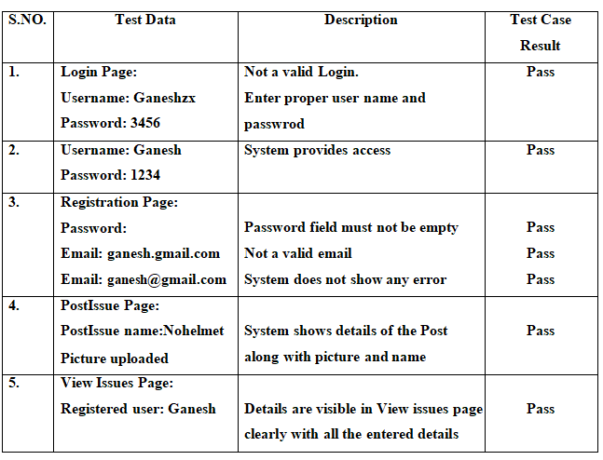
Testing Screenshot

Slide 63
Conclusion:
By the help of this project we can make everyone has to aware of traffic rules and must follow, Otherwise you will be punished by anyone.

Slide 64
Furture Enhancement
Always I follow the traffic rules updates from the concern government and update in violation types.
I will follow the feedback given by the users and if any reasonable suggestions found, I will follow with that and try to implement in the project

Slide 65
Continue...
There is always a room for improvement in any software package,however good and efficient it may be.
The important thing is that the application should be flexible enough for further modifications.
Considering this important factor,the application is designed in such a way that the provisions are given for furture enhancements

Slide 66
References: bOOK rEsources:
1.E.Balagurusamy, “Programming in Java”, 5th Edition, BPB Publications, 2010
2.Herbert Schildt, “Java – The Complete Reference”, 4th Edition, McGrawHill, 2014
3.Abraham Silberscatz, Korth, Sudarshan – Database Management Systems, 4th Edition, McGrawHill, 2002
4.Bruce Eckel, Thinking in Java, 2nd Edition, Prentice Hall, June 2000.
5.Hans Bergsten, Java Server Pages, Oreille, 3rd Edition December 2003

Slide 67
Continue...
6. Prophet, MySQL Database" Reference 10g Release 1 (10.1), Recovered 2008-11-17.
7. Roger S.Pressman, Software Engineering-A Practioners Approach, McGraw-Hill, 2005
8. Santosh Kumar K and Cogent Solutions Inc, JDBC, Servlets, and JSP, Version 6.
9. Bahlmann C., Ying Z., Ramesh V., Pellkofer M., Koehler T. A system for traffic sign detection, tracking, and recognition using color, shape, and motion information. Proceedings of Intelligent Vehicles Symposium; Las Vegas, NV, USA. 6–8 June 2005; pp. 255–260. [Google Scholar]

Slide 68
web resources:
1.www.java2share/jdbcconnectivity.html
2.www.way2java/jspintroduction.html
3.www.java2s/javapagesexamples.solvedexamples.html
4.www.roseindia/dbconnectivity.html
5.www.javatpoint/htmlregistration/example.html
6.www.ajava2all/connectingjavawithtml.html
7.www.booksboon.com

Slide 69


Thank You!

